Slide 1



NeuroFleetX – AI Driven Urban Mobility Optimization System
A Smart Fleet, Booking & Telemetry Management Platform
Submitted By: Payal Sahu
Infosys Springboard Virtual Internship 6.0 – Batch 5
Notes:
1

Slide 2

Problem Statement
Urban Mobility Challenges
Urban transportation systems today struggle with fragmented operations and outdated management approaches. Key pain points include:
Poor fleet coordination leading to underutilized vehicles
Inefficient routing causing delays and fuel wastage
Reactive maintenance resulting in unexpected breakdowns
Manual driver allocation creating bottlenecks
Scattered data preventing informed decision-making
Organizations urgently need a unified intelligent platform that seamlessly integrates fleet tracking, booking automation, predictive analytics, and AI-driven optimization.
Notes:
2

Slide 3
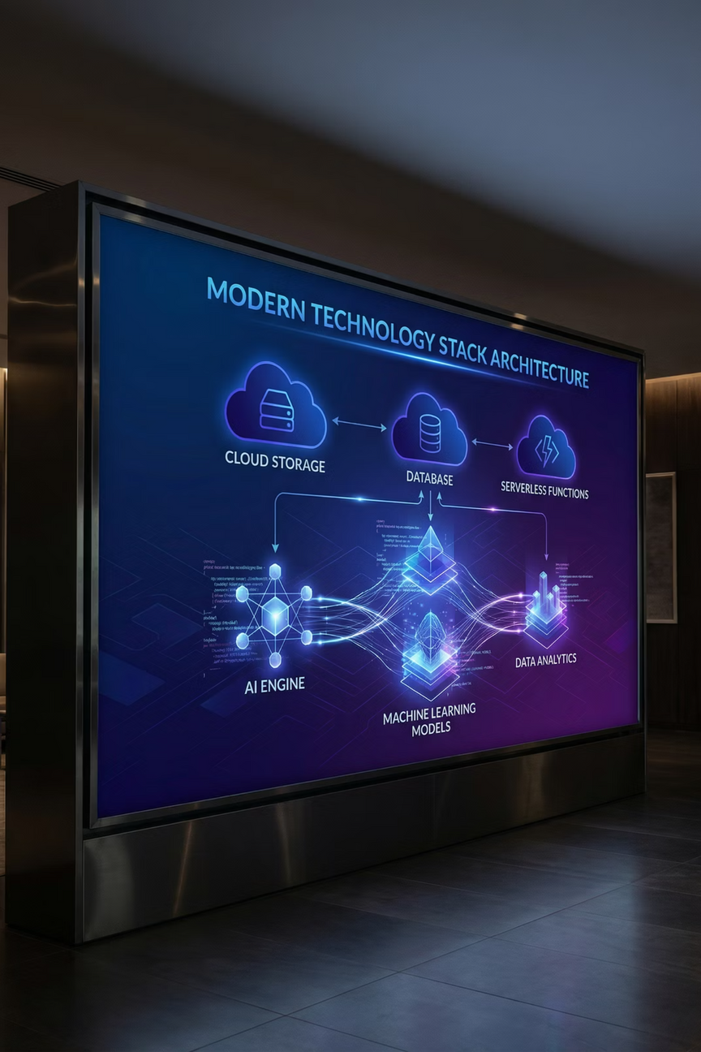
Proposed Solution
NeuroFleetX is an AI-powered fleet and mobility optimization system that transforms urban transportation through intelligent automation and real-time insights. The platform integrates advanced telemetry, automated booking intelligence, predictive analytics, and intuitive dashboards tailored for Admin, Driver, and Customer roles.
Frontend Layer
ReactJS, Tailwind CSS, ShadCN UI components for responsive interfaces
Backend Engine
Java Spring Boot for robust API services and business logic
Database & Auth
Firebase Auth, Firestore, Realtime Database for scalable storage
AI & Integration
Cloud Functions, Custom Route Engine, Google Maps API, JWT security
Notes:
3

Slide 4


Module 1: Authentication & Role Management
Secure Multi-Role Access
The authentication module provides enterprise-grade security using Firebase Authentication combined with JWT token management. Each user type—Admin, Customer, and Driver—experiences a customized interface designed for their specific needs and workflows.
01
User Login
Secure credential verification with Firebase Auth
02
Role Detection
System identifies user type and permissions
03
Dashboard Routing
Automatic navigation to role-specific interface
Security Features: JWT tokens, role-based access control (RBAC), encrypted communications, and session management ensure complete data protection.
Notes:
4

Slide 5

Regsitration Page

Slide 6

Login Page

Slide 7




Module 2: Fleet Inventory & Vehicle Telemetry
Real-Time Engine Health
GPS Location Tracking
Vehicle Status Dashboard
Continuous monitoring of engine parameters, temperature, RPM, and performance metrics with instant alerts for anomalies.
Live vehicle positioning with geofencing capabilities, route history, and automated location updates every few seconds.
Comprehensive view of entire fleet inventory from a centralized admin panel with filtering and search capabilities.
The telemetry system collects and processes thousands of data points per vehicle daily, enabling administrators to make data-driven decisions about fleet deployment, maintenance scheduling, and operational efficiency improvements.
Notes:
5

Slide 8
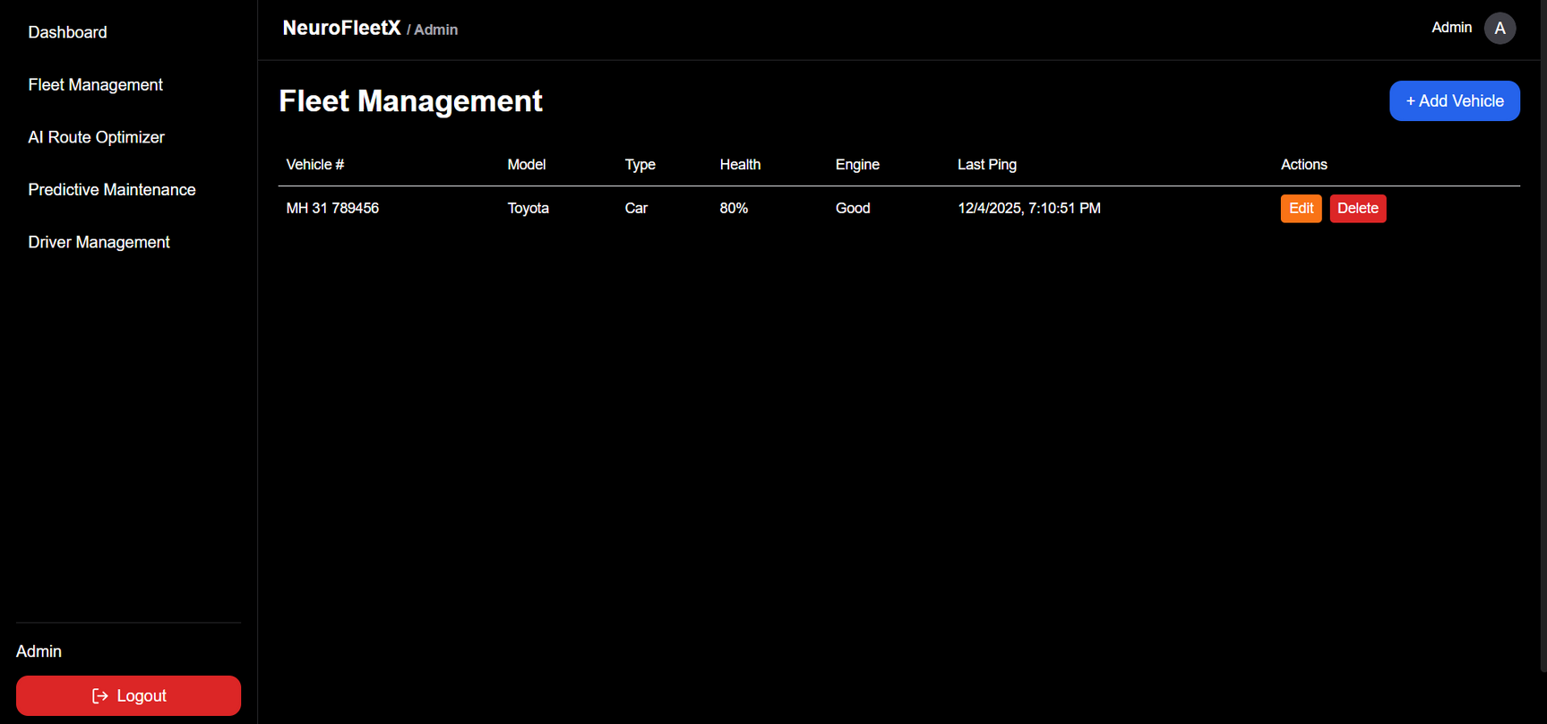
Fleet Management Page

Slide 9
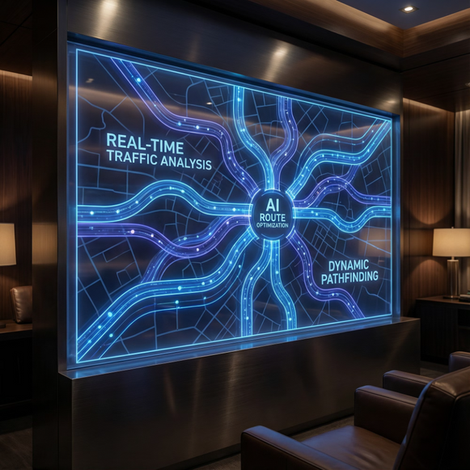

Module 3: AI Route & Load Optimization Engine
Intelligent Path Planning
The AI-powered optimization engine revolutionizes fleet efficiency by computing the most efficient travel routes in real-time. The system analyzes multiple factors simultaneously:
Traffic Analysis
Real-time traffic data integration for dynamic route adjustments
Distance Optimization
Shortest path algorithms considering road conditions and restrictions
Load Balancing
Maximum fleet utilization with intelligent vehicle-to-task assignment
Fuel Efficiency
Route selection prioritizing reduced fuel consumption and emissions
Impact: Organizations typically see 20-30% reduction in fuel costs and 25% improvement in on-time deliveries after implementing AI route optimization.
Notes:
6

Slide 10
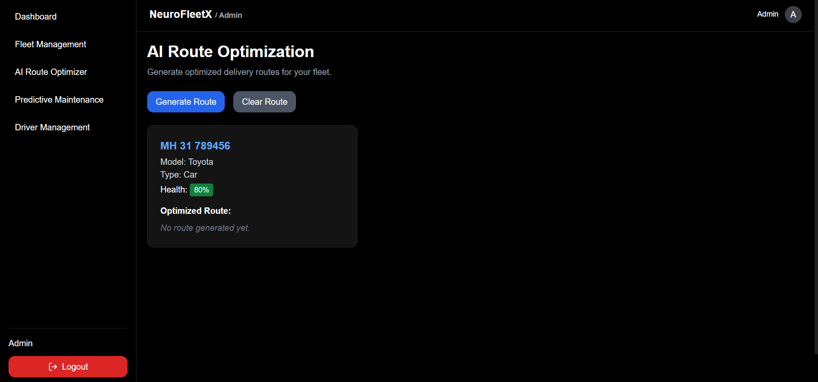
AI Route Optimization Page

Slide 11





Module 4: Predictive Maintenance & Health Analytics
Transform from reactive to proactive maintenance with AI-driven predictions that identify potential vehicle failures before they occur. The system analyzes historical telemetry data, usage patterns, and component lifecycles to forecast maintenance needs.
Data Collection
AI Analysis
Continuous telemetry and usage tracking
Machine learning identifies failure patterns
Early Alerts
Scheduled Service
Proactive notifications before breakdown
Planned maintenance reduces downtime
Health Monitoring
Maintenance Alerts
Cost Savings
Visual charts display engine risk indicators, component wear levels, and overall vehicle health scores
Automated notifications for upcoming service requirements based on predictive models
Prevent expensive emergency repairs through timely intervention and planned maintenance
Notes:
7

Slide 12
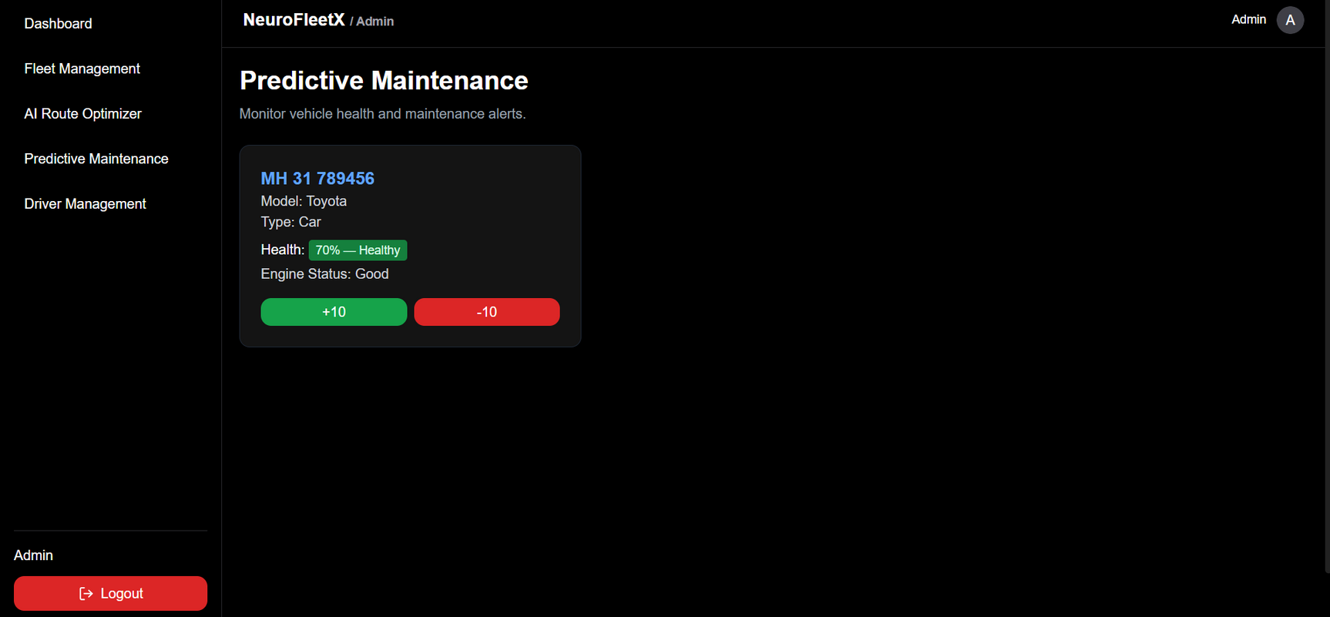
Predictive Maintenance Page

Slide 13
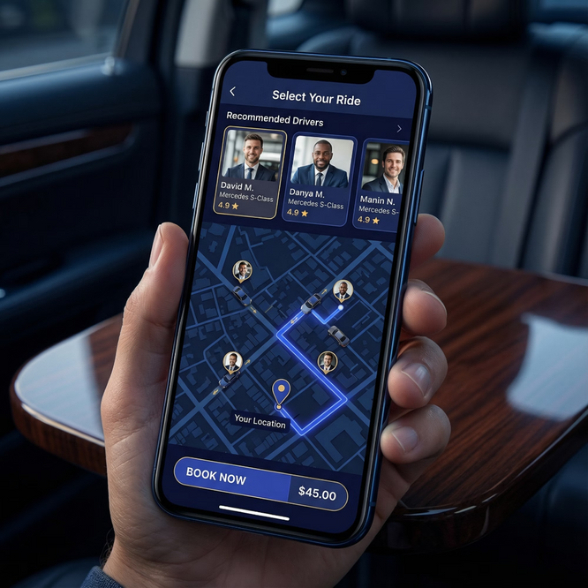



Module 5: Customer Booking & Smart Recommendations
Intelligent Booking System
Customers experience a seamless booking process enhanced by AI-driven recommendations. The system automatically analyzes multiple parameters to suggest the optimal driver-vehicle combination for each ride request.
Smart Matching
AI evaluates driver proximity, availability, and vehicle suitability
Real-Time ETA
Accurate arrival time predictions based on current traffic conditions
Quality Scoring
The intelligent recommendation engine ensures customers get the best service while optimizing overall fleet utilization and driver satisfaction.
Driver ratings and vehicle condition factor into recommendations
Recommendation Factors
Geographic distance and route efficiency
Driver availability and current workload
Vehicle health and maintenance status
Historical performance and customer ratings
Notes:
8

Slide 14
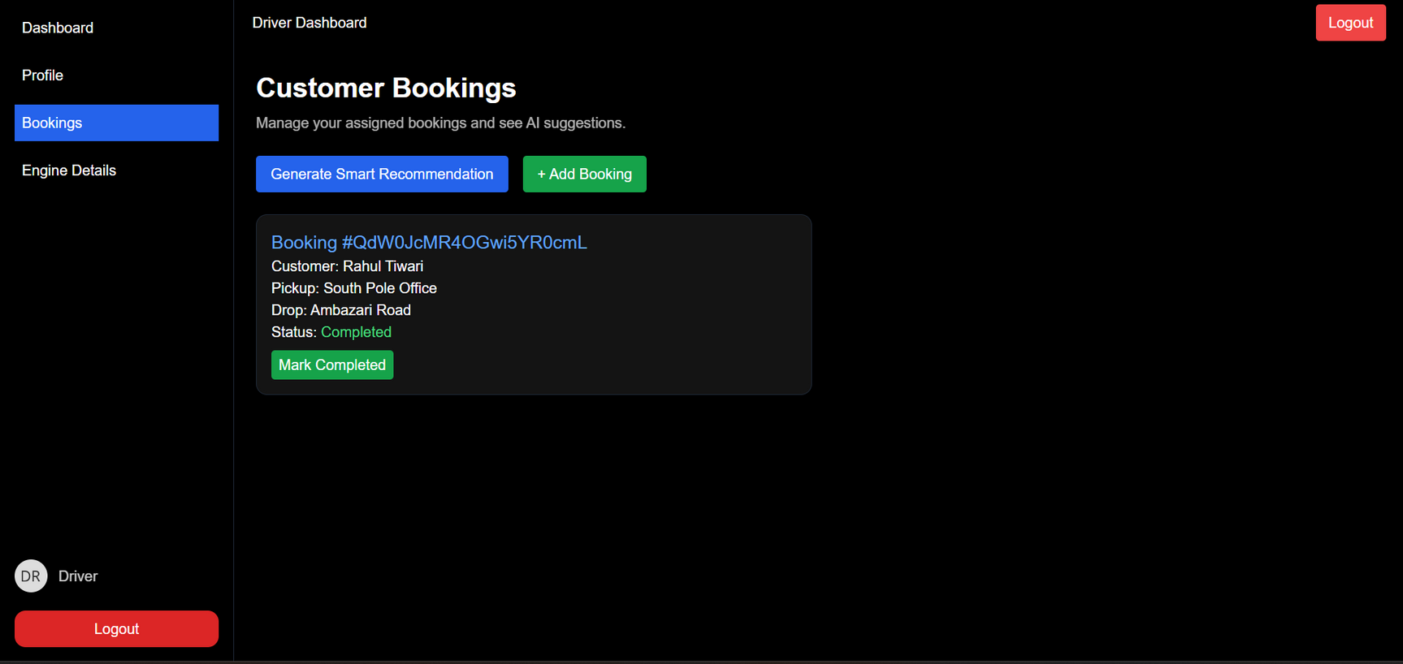
Booking Page

Slide 15
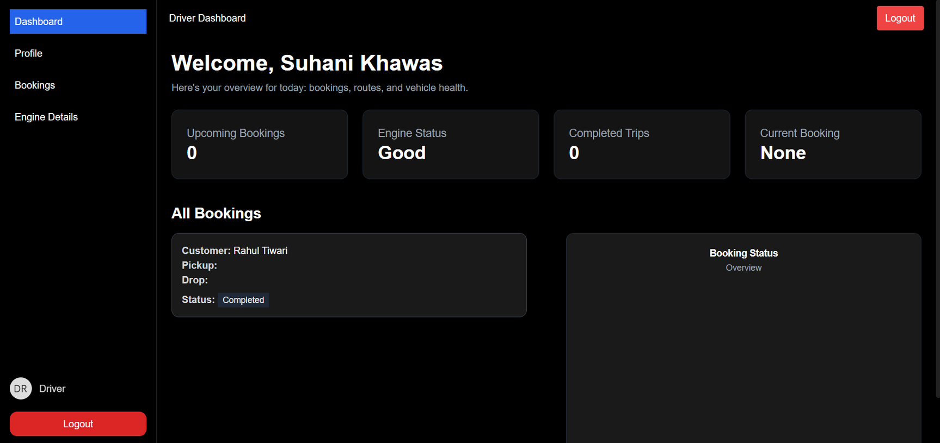
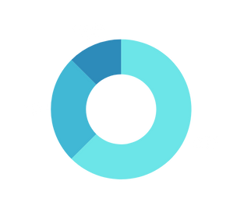
Driver Dashboard Page

Slide 16

Module 6: Admin Dashboard & Urban Mobility Insights
The comprehensive admin dashboard transforms raw data into actionable insights for strategic decision-making. Administrators gain a bird's-eye view of entire fleet operations through interactive visualizations and real-time analytics.
100%
24/7
360°
Fleet Visibility
Monitoring
Analytics
Complete real-time overview of all vehicles and operations
Continuous tracking and instant alert notifications
Comprehensive insights across all operational dimensions
Key Metrics Tracked
Data-Driven Benefits
Total bookings and revenue trends
Visual charts and interactive dashboards enable administrators to identify patterns, optimize resource allocation, forecast demand, and implement strategic improvements for smarter urban mobility planning.
Fleet performance and utilization rates
Driver statistics and efficiency scores
Vehicle health and maintenance schedules
Route optimization effectiveness
Export reports in multiple formats for stakeholder presentations and compliance documentation.
Customer satisfaction and feedback
Notes:
9

Slide 17
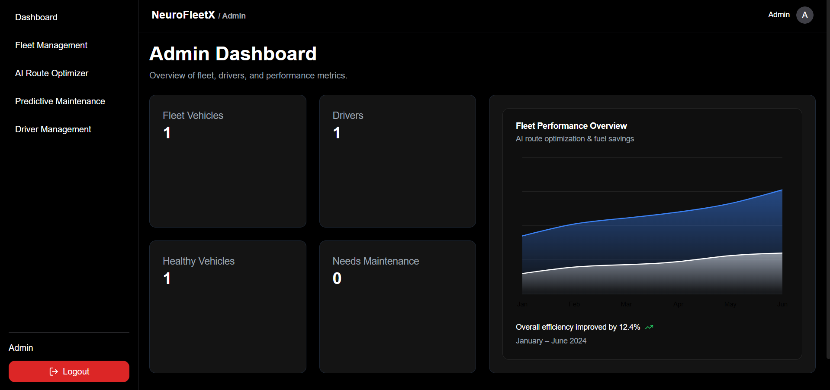
Admin Dashboard Page

Slide 18
Conclusion
NeuroFleetX represents a paradigm shift in urban mobility management by centralizing fleet operations, booking automation, telemetry monitoring, route optimization, and administrative analytics into one intelligent, unified platform.
AI-Driven Automation
Predictive Maintenance
Real-Time Insights
Intelligent algorithms optimize every aspect of fleet operations, from route planning to driver allocation
Proactive vehicle health monitoring prevents costly breakdowns and extends fleet lifespan
Comprehensive dashboards and analytics enable data-driven strategic decision-making
"By enhancing operational efficiency, reducing costs, and improving service quality, NeuroFleetX empowers organizations to meet the evolving demands of modern urban transportation systems."
Thank You!
Presented by: Payal Sahu
Infosys Springboard Virtual Internship 6.0 – Batch 5
Notes:
10

